Slide 1
Lecture 3
Most material from Fei Fei Li’s course at Standford University

Slide 2
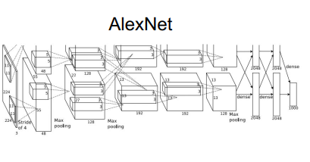
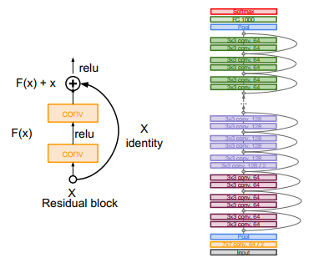
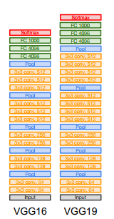
Last time: CNN Architecture
ResNet

Slide 3
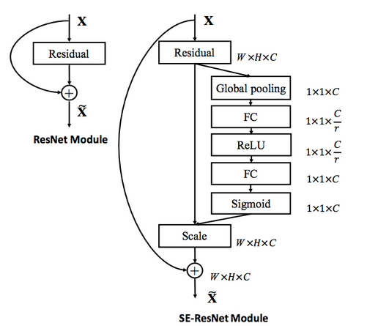
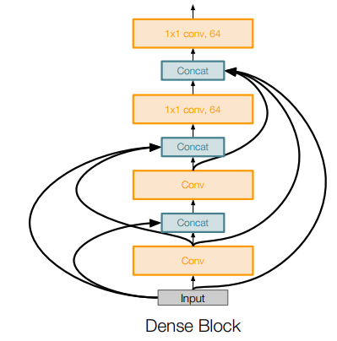
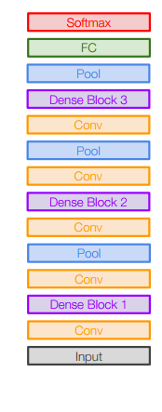
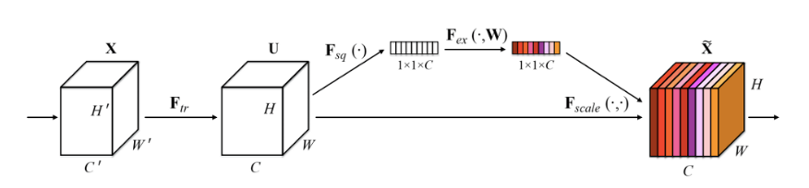
Last time: CNN Architecture
SENet
DenseNet

Slide 4
Today
Preprocessing
Weight Initialization
Batch Normalization
Hyper-Parameter Tuning
Transfer Learning
Segmentation

Slide 5
Preprocessing

Slide 6
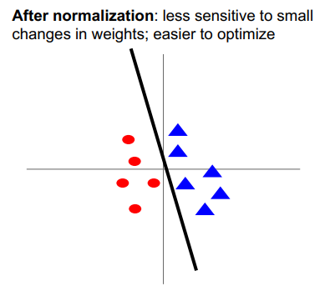
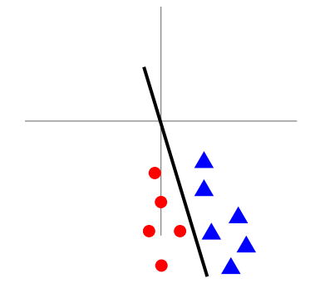
Preprocessing:
Before normalization: classification loss very sensitive to changes in weight matrix; hard to optimize

Slide 7
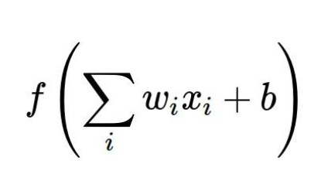
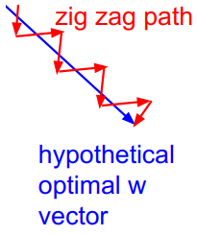
Preprocessing:
Consider what happens when the input to a neuron is always positive...
What can we say about the gradients on w?
Always all positive or all negative :(

Slide 8
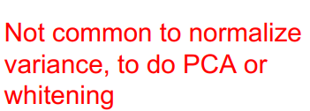
Preprocessing:
In practice for Images: center only
e.g. consider CIFAR-10 example with [32,32,3] images
- Subtract the mean image (e.g. AlexNet) (mean image = [32,32,3] array)
- Subtract per-channel mean (e.g. VGGNet) (mean along each channel = 3 numbers)

Slide 9
Weight Initialization

Slide 10
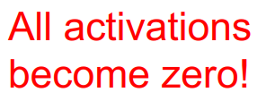
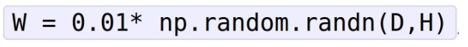
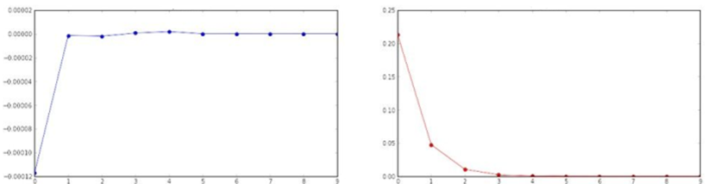
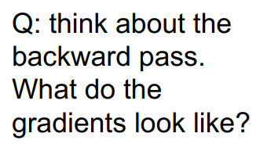
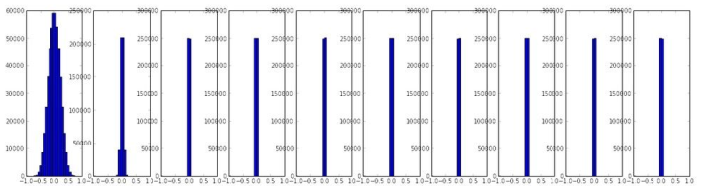
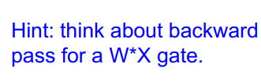
Weight Initialization:
Activation is tanh
Layer mean
Layer std

Slide 11
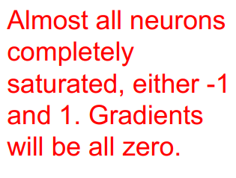
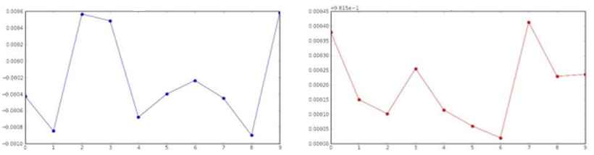
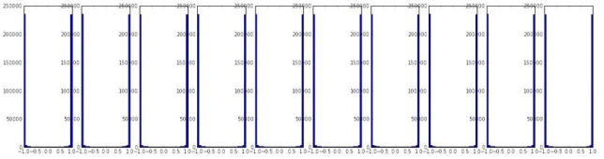
Weight Initialization:
Layer mean
Layer std

Slide 12
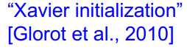
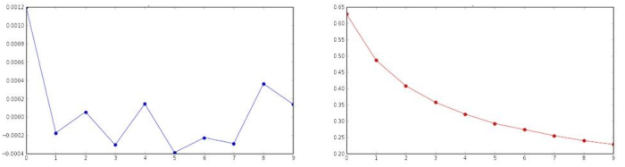
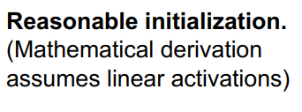
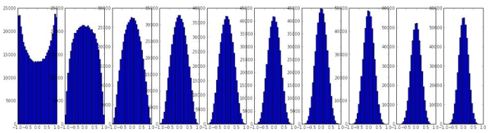
Weight Initialization:
Layer mean
Layer std

Slide 13
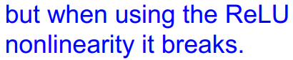
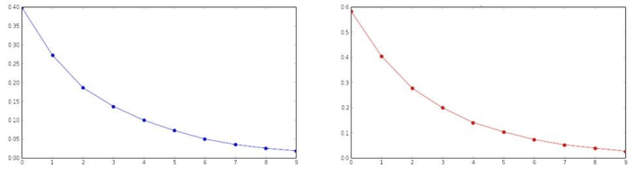
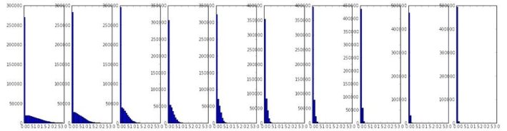
Weight Initialization:
Layer mean
Layer std

Slide 14
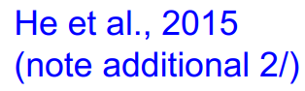
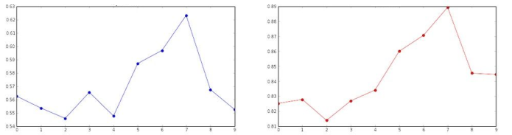
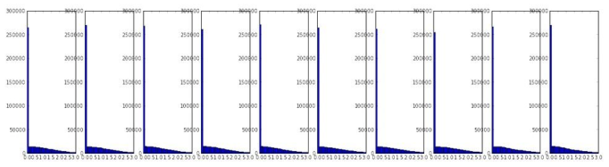
Weight Initialization:
Layer mean
Layer std

Slide 15
Batch Normalization

Slide 16
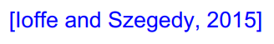
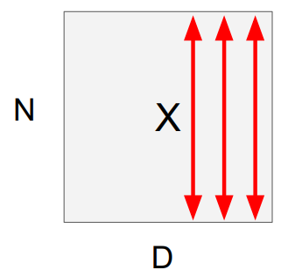
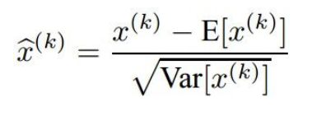
Batch Normalization:
“you want zero-mean unit-variance activations? just make them so.”
1. compute the empirical mean and variance independently for each dimension.
2. Normalize

Slide 17
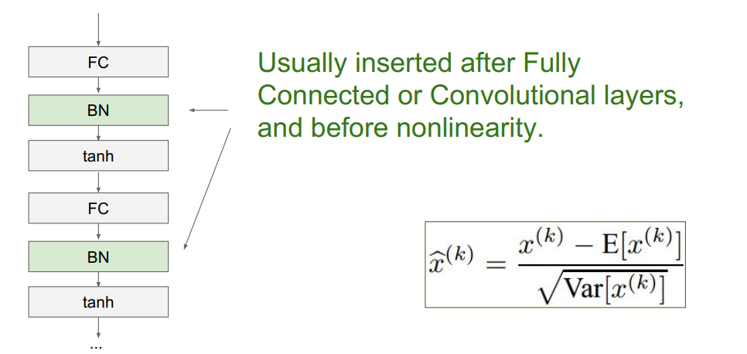
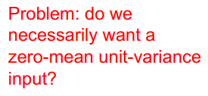
Batch Normalization:

Slide 18
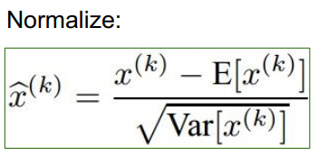
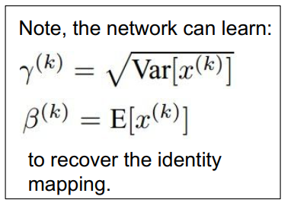
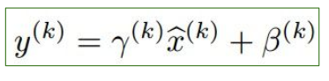
Batch Normalization:
And then allow the network to squash the range if it wants to:

Slide 19
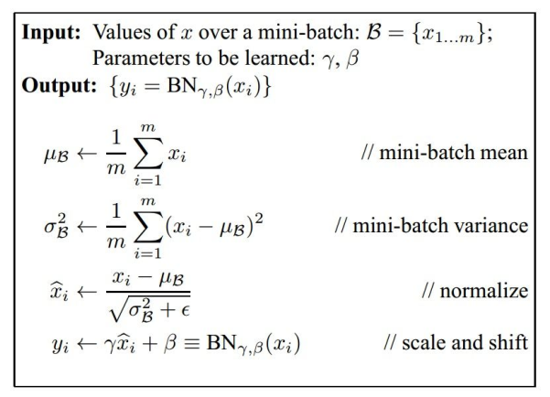
Batch Normalization:
- Improves gradient flow through the network
- Allows higher learning rates
- Reduces the strong dependence on initialization
- Acts as a form of regularization in a funny way, and slightly reduces the need for dropout, maybe

Slide 20
Batch Normalization:
Note: at test time BatchNorm layer functions differently:
The mean/std are not computed based on the batch. Instead, a single fixed empirical mean of activations during training is used.
(e.g. can be estimated during training with running averages)

Slide 21
Hyper-Parameter Tuning

Slide 22
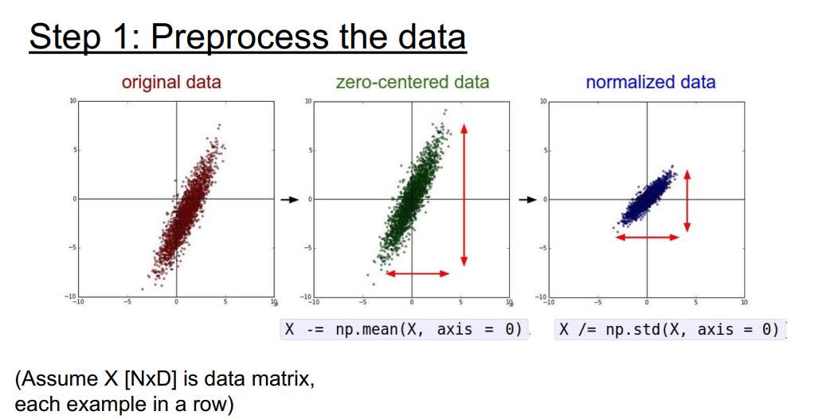
Hyper-Parameter Tuning

Slide 23
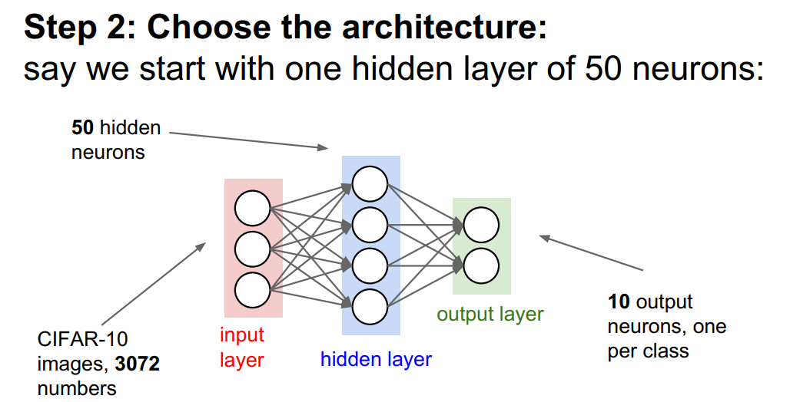
Hyper-Parameter Tuning

Slide 24
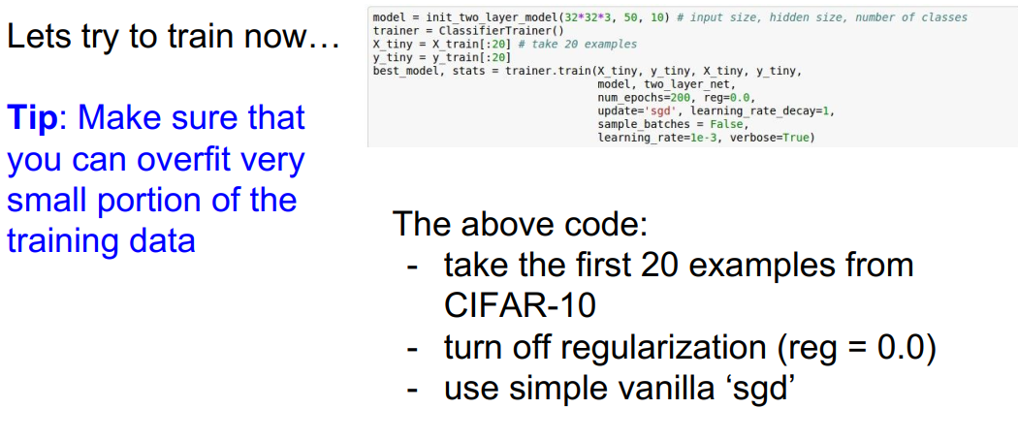
Hyper-Parameter Tuning

Slide 25
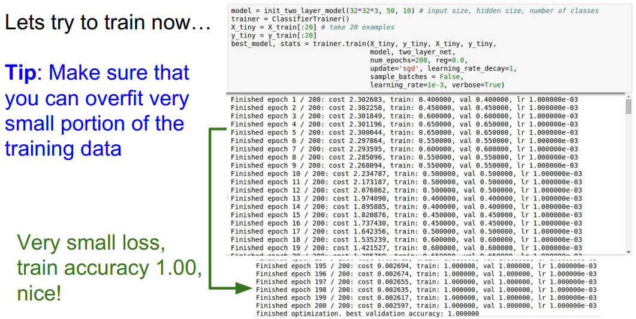
Hyper-Parameter Tuning

Slide 26
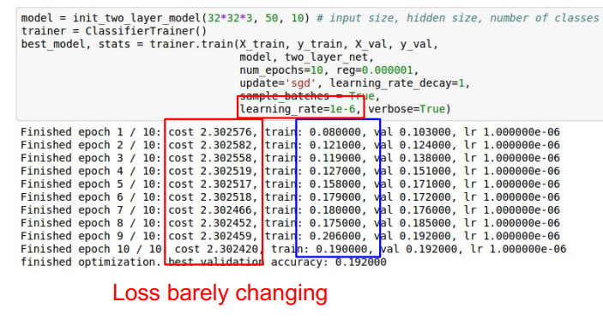
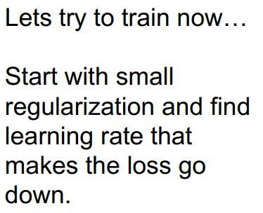
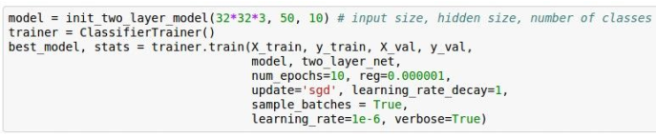
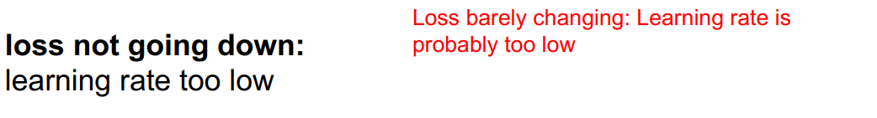
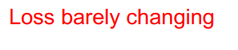
Hyper-Parameter Tuning

Slide 27
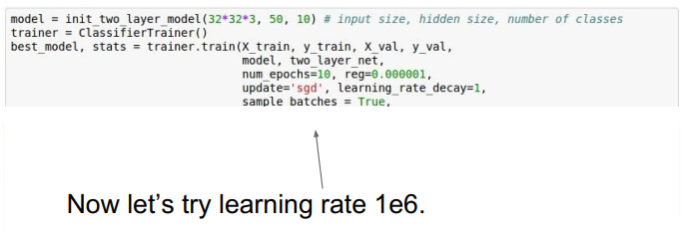



Hyper-Parameter Tuning

Slide 28


Hyper-Parameter Tuning

Slide 29

Hyper-Parameter Tuning
Note it’s best to optimize in log space!!
nice

Slide 30





Hyper-Parameter Tuning

Slide 31

Hyper-Parameter Tuning

Slide 32
Transfer Learning

Slide 33

Transfer Learning

Slide 34

Transfer Learning

Slide 35




Transfer Learning

Slide 36

Transfer Learning

Slide 37

Transfer Learning

Slide 38

Transfer Learning

Slide 39
Image Segmentation

Slide 40

Image Segmentation:

Slide 41




Image Segmentation:

Slide 42

Image Segmentation:

Slide 43



Image Segmentation:

Slide 44


Image Segmentation:

Slide 45


Image Segmentation:
Next Lecture…

Slide 46

Image Segmentation:
UNet
filters=1
Padding=Same
Dropout=0.5

Slide 47
UNet Architecture:
The left hand side is the contraction path (Encoder) where we apply regular convolutions and max pooling layers
In the decoder, the size of the image gradually increases and the depth gradually decreases
The Decoder recovers the “WHERE” information (precise localization) by gradually applying up-sampling
In the Encoder, the size of the image gradually reduces while the depth gradually increases.
Network learns the “WHAT” information in the image, however it has lost the “WHERE” information
To get better precise locations, at every step of the decoder, skip connections by concatenating the output of the Upsample layers with the feature maps from the Encoder has been used
Droput 0.5 is used to prevent over-fitting
The right hand side is the expansion path (Decoder) where Upsampling, along with regular convolutions are applied
After every concatenation two consecutive regular convolutions are applied so that the model can learn to assemble a more precise output
[Ronneberger et al., 2015. Convolutional Networks for Biomedical Image Segmentation]

Slide 48
Next time: Visualizing CNN features
Auto-Encoders

